Slide 1











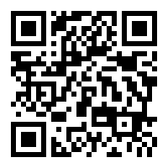
VISION
LIVE GREEN! INITIATIVES
works to encourage all
students including alumni and all faculties to be committed and be engaged in the effort of our school to be as ‘green’ as possible. We hold ambition to make ISU a leader in sustainability among land-grant institutions.
Find us here! #iowastate #livegreen
LIVE GREEN! INITIATIVES
OFFICE OF SUSTAINABILITY
Room 108 General Svcs
700 Wallace Rd
Ames, IA 50011-4013City
LIVEGREEN@IASTATE.EDU
Brochure subtitle or company tagline

Slide 2
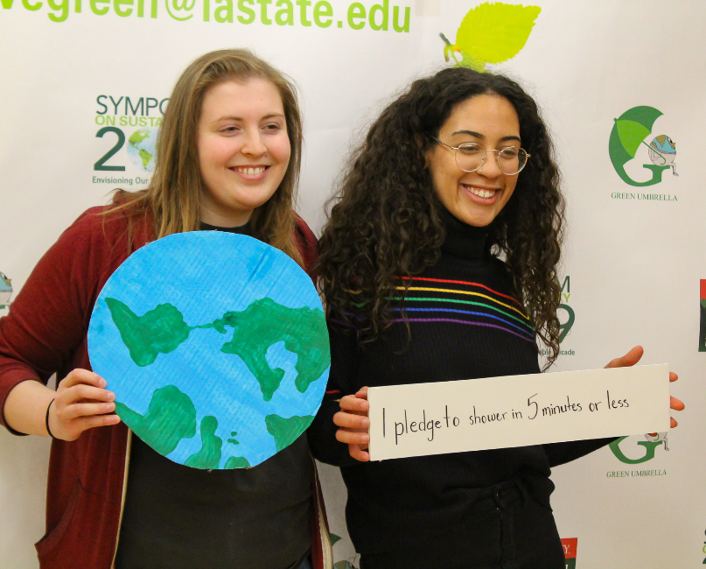







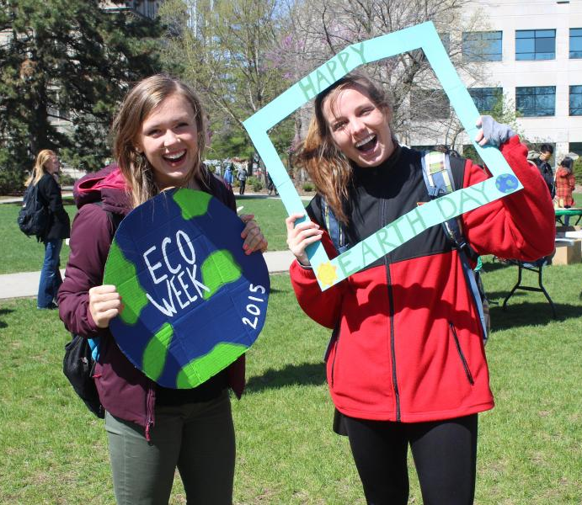



TEN WAYS TO LIVE GREEN
RESOURCES FOR YOUR
LIVE GREEN ADVENTURE…
Purchase with Purpose
STUDY GREEN
Look up Live Green! Sustainability course directory.
JOIN A GREEN CLUB
Search through student organization database!
LEARN WITH SUSTAINABLE FRIENDS
STAY IN THE GREEN KNOW
Keep connected with events and opportunities!
GIVE BACK AND PAY FORWARD
Be a volunteer!
Not around, Turn it Down
Green Your Ride
PAST EVENTS
Green Bag It
Stash The Trash
06 Apr 2019 8:00 am @ Reiman Gardens
Unplug the Unused
Lecture: Vans, Empowering Youth Culture
11 Apr 2019 7:00 pm @ Sun Room, Memorial Union
Twist Your Lights
Lecture: Empowering the Next Generation of Engineers
23 Apr 2019 4:00 pm @ Alliant Energy-Lee Liu Auditorium, Howe Hall
Make your Flow
Bring your own Bottle
Earth Month Celebration
25 Apr 2019 10:00 am @ South Library Lawn
Power Down
Remember the 4 Rs

